Slide 1
CIRCUIT THEORY DIFFERENTIAL EQUATIONS 1
Declaration : The content of the presentation has been created for academic use / non-commercial use with fair dealing.

Slide 2
SYED HASAN SAEED
Email
hasansaeedcontrol@gmail.com
URL
http://shasansaeed.yolasite.com/
http://hasansaeed872726549.wordpress.com/
http://syedhasansaeed.gnomio.com/

Slide 3
REFERENCE BOOKS
Introductory Circuit Analysis, Robert L. Boylested, Pearson Education, Prentice Hall.
Networks And Systems, Ashfaq Husain, Khanna Book Publishing Co (P) Ltd. Delhi.
Networks And Systems, A Sudhakar, Shyammohan S Palli, Tata McGraw Hill, New Delhi.
Network Analysis, M.E. Van Valkenburg, PHI Learning Private limited, New Delhi.
Circuit Analysis Principle and Applications, Allan H. Robbins &Wilhelm C. Miller, DELMAR CENGAGE Learning, Indian Reprint.

Slide 4
DIFFERENTIAL EQUATIONS
A differential equation is one which involves derivatives of one or more dependent variables with respect one or more independent variables.
in equation (1) ‘x’ is an independent variable & ‘y’ is a dependent variable, in equation (2) ‘t’ is an independent variable & ‘x’ is a dependent variable.

Slide 5
DIFFERENTIAL EQUATIONS
The order of differential equation is the order of the higher derivatives in it.
Equation (1) is the order of ‘1’ and equation (2) is the order of the 3.
Differential Equations
Linear Differential Equations
Non-Linear Differential Equations

Slide 6
DIFFERENTIAL EQUATIONS
A linear ordinary differential equation of the order ‘n’, in the independent variable ‘x’ and dependent variable ‘t’ is given as
The order of the equation is (3) ‘n’.
Example of non-linear differential equation is

Slide 7
DIFFERENTIAL EQUATIONS
If c (t) = 0, the equation is said to be homogeneous, otherwise it is non-homogeneous.
Non-homogeneous equation

Slide 8
DIFFERENTIAL EQUATIONS
The general solution may be written as
x = x_{c} + x_{P} ----------(5)
Where x_{c} is ‘complementary function’ and x_{P} is ‘particular integral’.
SECOND ORDER DIFFERENTIAL EQUATION:

Slide 9
DIFFERENTIAL EQUATIONS
The solution of the second order equation depends upon the type of the roots.
The roots may be distinct real, real & repeated and complex conjugate.

Slide 10
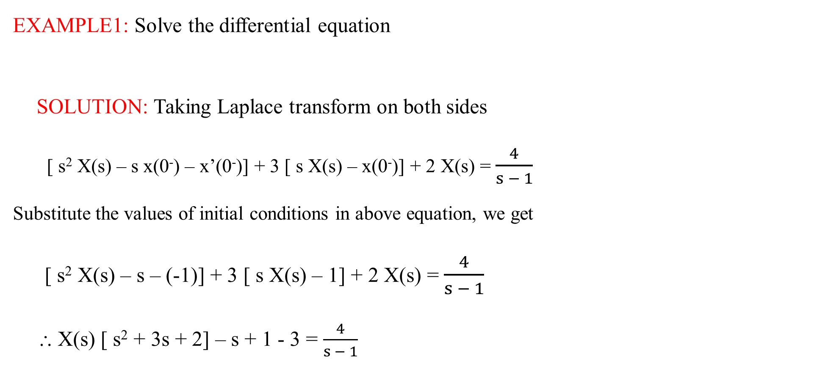
DIFFERENTIAL EQUATIONS
EXAMPLE1: Solve the differential equation
SOLUTION: Taking Laplace transform on both sides
[ s² X(s) – s x(0⁻) – x’(0⁻)] + 3 [ s X(s) – x(0⁻)] + 2 X(s) = $\frac{4}{s − 1}$
Substitute the values of initial conditions in above equation, we get
[ s² X(s) – s – (-1)] + 3 [ s X(s) – 1] + 2 X(s) = $\frac{4}{s − 1}$
⸫ X(s) [ s² + 3s + 2] – s + 1 - 3 = $\frac{4}{s − 1}$

Slide 11

DIFFERENTIAL EQUATIONS
X(s) [ s² + 3s + 2] = $\frac{4}{s − 1}$ + s + 2
X(s) [ s² + 3s + 2] = $\frac{4 + (s − 1) (s + 2)}{(s − 1)}$
X(s) [ s² + 3s + 2] = $\frac{4 + s^{2} + s − 2}{(s − 1)}$
X(s) = $\frac{s^{2} + s + 2}{(s − 1) (s^{2} + 3s + 2)}$ = $\frac{s^{2} + s + 2}{(s − 1) (s + 1) (s + 2) }$
Taking inverse Laplace using partial fraction
X(s) = $\frac{A}{(s − 1)}$ + $\frac{B}{(s + 1)}$ + $\frac{C}{(s + 2)}$
Where A = (s – 1) X(s)│_{s = 1} = $\frac{2}{3}$

Slide 12

DIFFERENTIAL EQUATIONS
Where B = (s + 1) X(s)│_{s = -1} = $−1$
C = (s + 2) X(s)│_{s = -2} = $\frac{4}{3}$
X(s) = $\frac{2/3}{(s − 1)}$ - $\frac{1}{(s + 1)}$ + $\frac{4/3}{(s + 2)}$
x(t) = $\frac{2}{3}$ $e^{t}$ - $e^{−t}$ + $\frac{4}{3}$ $e^{−2}$

Slide 13
EXAMPLE 2: Solve the differential equation
SOLUTION: Take Laplace transform
ℒ ⁻¹
ℒ ⁻¹

Slide 14
DIFFERENTIAL EQUATIONS 1
SOLUTION OF DIFFERENTIAL EQUATION USING LAPLACE TRANSFORM:
EXAMPLE 4: Solve the differential equation

Slide 15

DIFFERENTIAL EQUATIONS 1
$\frac{s^{2}+6s+5}{s(s^{2}+4s+5)}$ = $\frac{As+B}{s^{2}+4s+5}$ + $\frac{C}{s}$ --------(3)
$\frac{s^{2}+6s+5}{s(s^{2}+4s+5)}$ = $\frac{s(As+B)+C(s^{2}+4s+5)}{s(s^{2}+4s+5)}$
$\frac{s^{2}+6s+5}{s(s^{2}+4s+5)}$ = $\frac{As^{2}+ Bs+ Cs^{2}+4sC + 5C}{s(s^{2}+4s+5)}$
$s^{2}$ + 6s + 5 = (A + C) s² + (B + 4C) s + 5 C
Compare the coefficients of ‘s’ on bot side
A + C = 1 ----(a)
B + 4C = 6 -----(b)
5C = 5 ----(c)

Slide 16
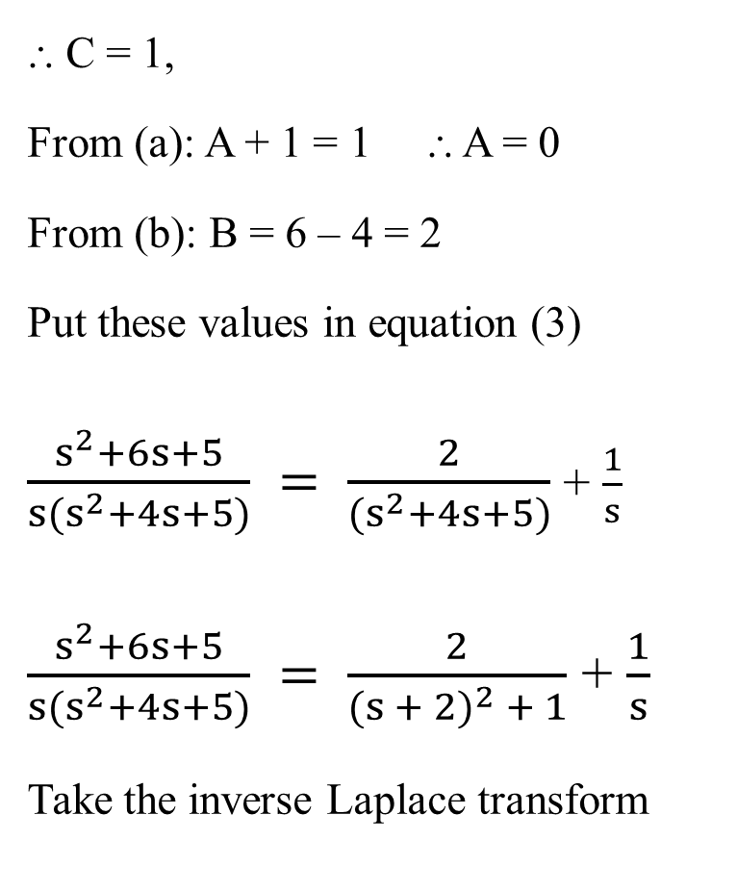

DIFFERENTIAL EQUATIONS 1
⸫ C = 1,
From (a): A + 1 = 1 ⸫ A = 0
From (b): B = 6 – 4 = 2
Put these values in equation (3)
$\frac{s^{2}+6s+5}{s(s^{2}+4s+5)} = \frac{2}{(s^{2}+4s+5)}$ + $\frac{1}{s}$
$\frac{s^{2}+6s+5}{s(s^{2}+4s+5)} = \frac{2}{{(s + 2)}^{2} + 1}$ + $\frac{1}{s}$
Take the inverse Laplace transform
i(t) = ℒ ⁻¹ $\left[\frac{2}{{(s + 2)}^{2} + 1}\right]$ + ℒ ⁻¹ $\frac{1}{s}$
i(t) = 2 $e^{−2t}$ sin(t) + 1
⸪ ℒ ⁻¹ $\left\{\frac{1}{{(s + a)}^{2} + b^{2}}\right\}$ = $e^{−at}$ sin(bt)
ℒ ⁻¹ $\left\{\frac{1}{s}\right\}$ = 1

Slide 17

DIFFERENTIAL EQUATIONS 1
EXAMPLE 5: Find the current i₂ in the given network using Laplace transform.
10Ω
1H
1H
+
10Ω
10Ω
100 u (t)
i₁
i₂
$$\text{Apply} \text{KVL} \text{in} \text{mesh} (1) \\ \text{− }\text{L} \frac{\text{di}}{\text{dt}}\text{ −10 }{\text{i}}_{1}\text{ − 10 }( {\text{i}}_{1}\text{ − }{\text{i}}_{2} ) +\text{ 100 }\text{u} (t) =\text{ 0} \\ \text{Put} \text{the} \text{value} \text{of}\text{ ′}\text{L}\text{′ }\text{and} \text{simplify} \text{the} \text{equation} \\ \frac{\text{d}{\text{i}}_{1}}{\text{dt}} +\text{ 20 }{\text{i}}_{1}\text{ − 10 }{\text{i}}_{2} =\text{ 100 }\text{u}(t)\text{ −−−−−−−− }(1)$$

Slide 18
DIFFERENTIAL EQUATIONS 1

Slide 19
DIFFERENTIAL EQUATIONS 1

Slide 20
THANK YOU
shasansaeed@yolasite.com
hasansaeed872726549.wordpress.com
saeed.moodlecloud.com
syedhasansaeed.gnomio.com

